Slide 1
IP Routers
Lecture X
CS 168, Fall 2024 @ UC Berkeley
Slides credit: Sylvia Ratnasamy, Rob Shakir, Peyrin Kao
Notes:
Slides template credit: Josh Hug, Lisa Yan

Slide 2
IP Routers in Real Life
IP Routers
Routers in Real Life
Router Components (Planes)
Packet Types
Forwarding in Hardware
Efficient Forwarding with Tries
Lecture X, CS 168, Fall 2024

Slide 3
Routers – Conceptually
Recall:
A router performs routing protocols to learn about routes.
A router receives packets and forwards them according to the forwarding table.
Today: What do routers actually look like in real life?
B
R2's Table
Destination | Port
A | 0
B | 1
C | 1
D | 2
R3
0
1
C
A
R1
R2
2
R4
D

Slide 4
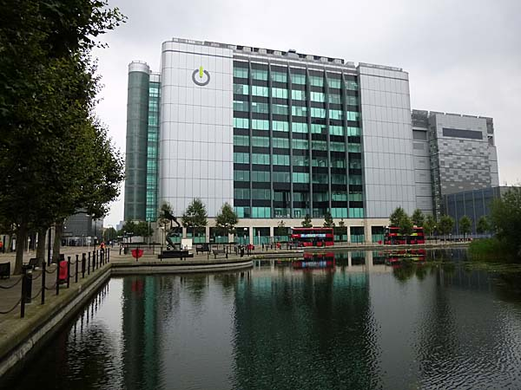
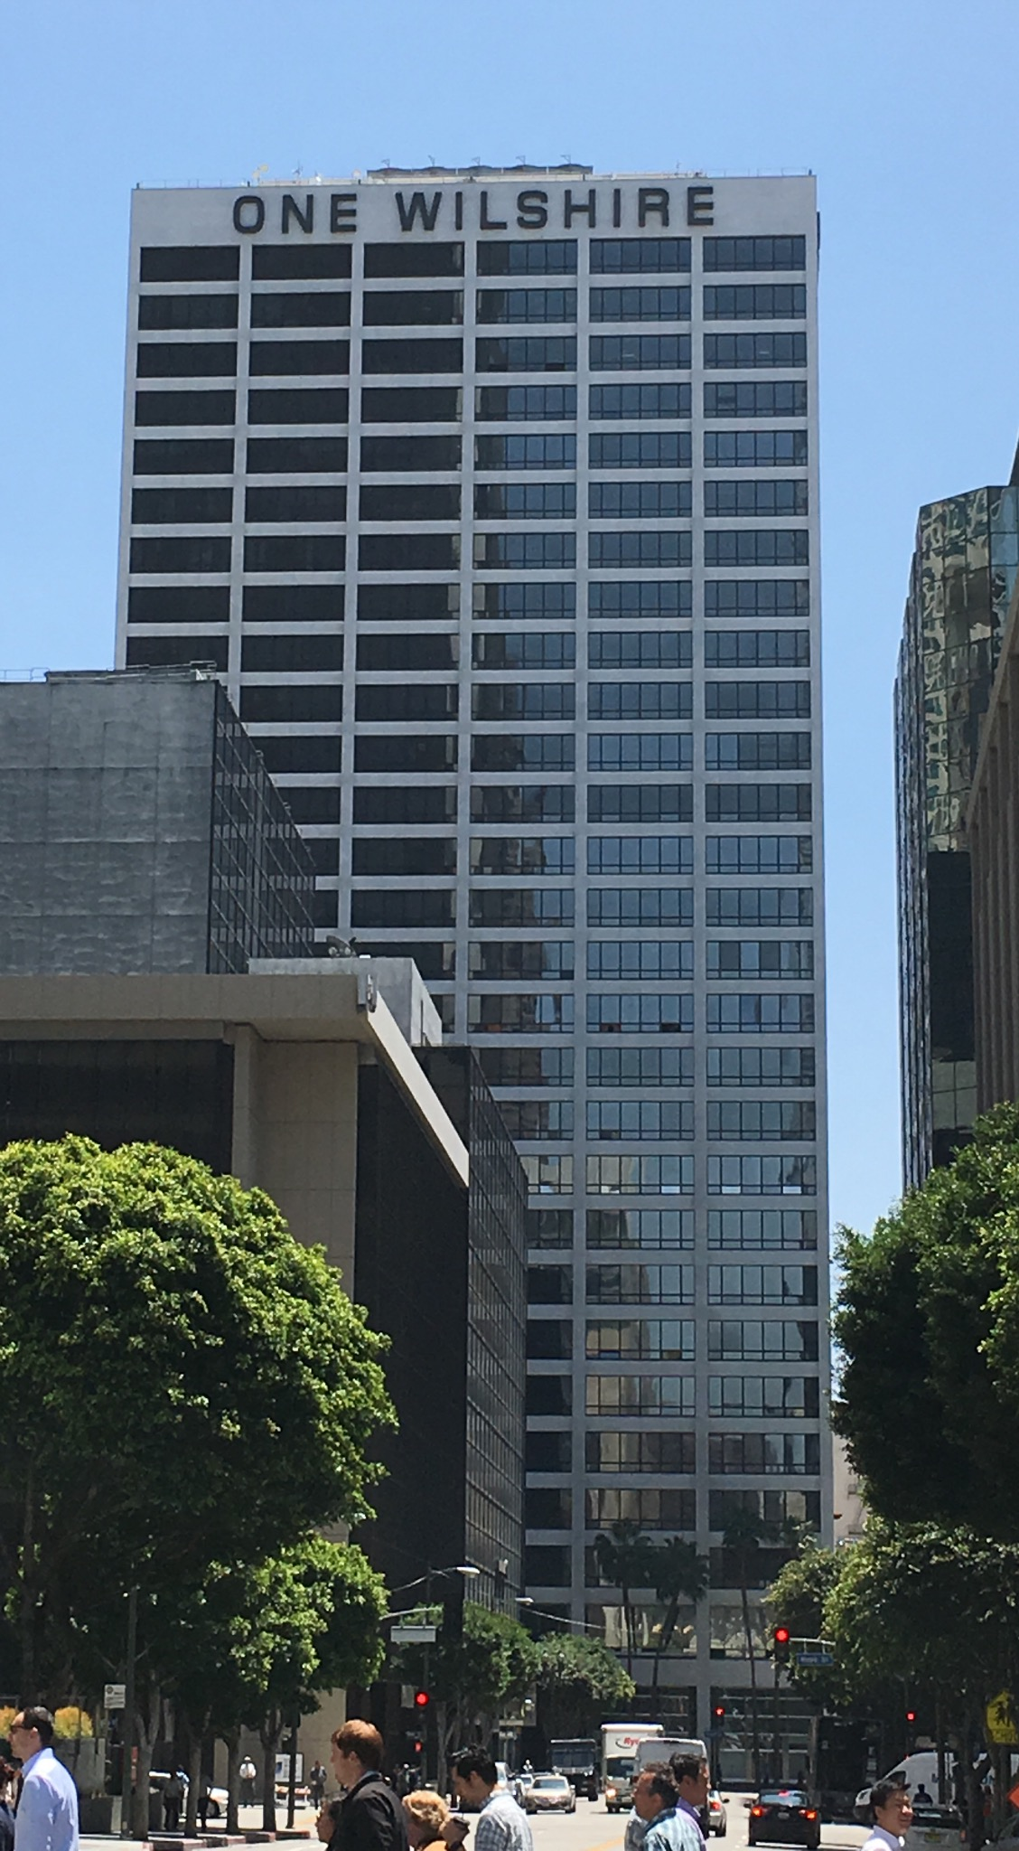
Colocation Facilities
Colocation facility (aka carrier hotel): A building where multiple ISPs install routers.
Allows for high-performance connections between networks.
In our diagrams, these routers would live in carrier hotels.

Slide 5
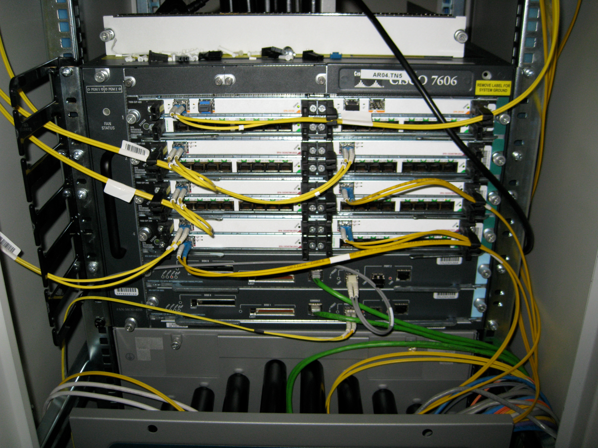
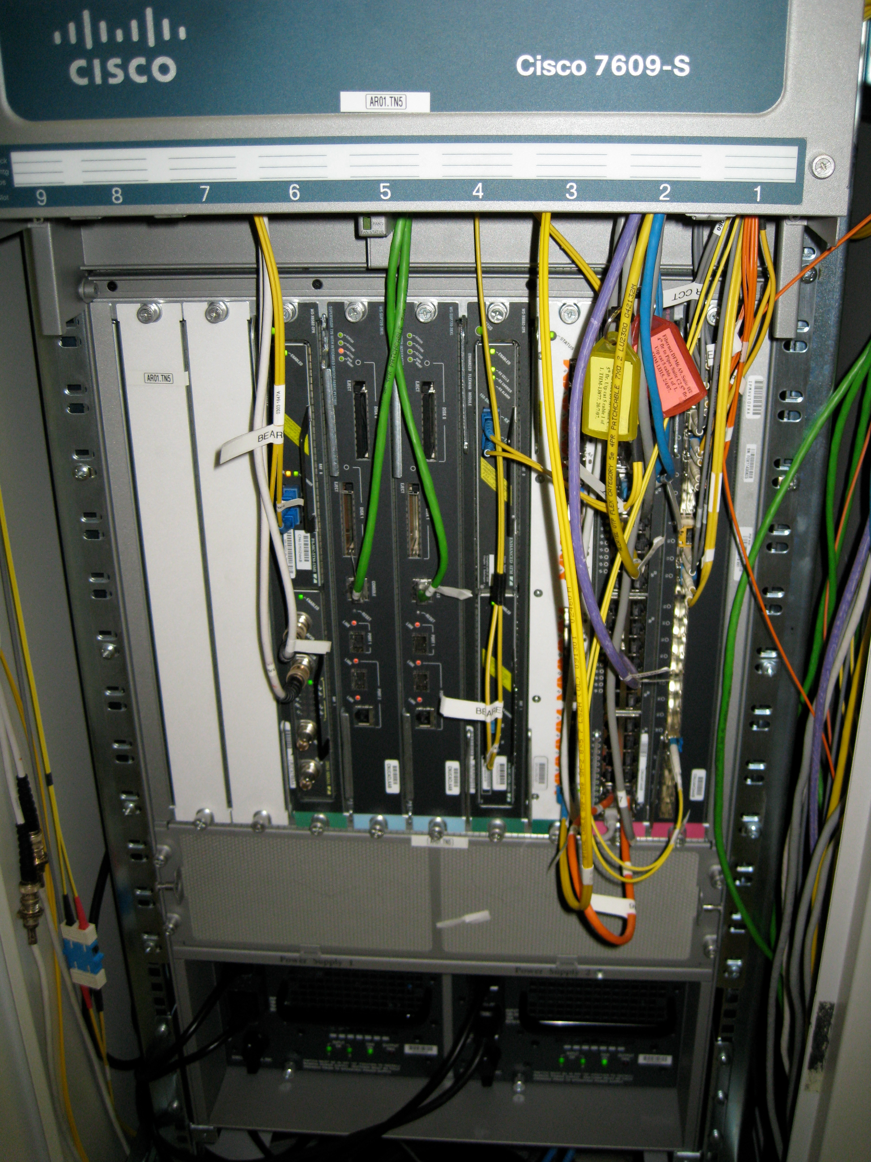
Routers in Real Life
A router is just a computer specialized for forwarding packets.

Slide 6
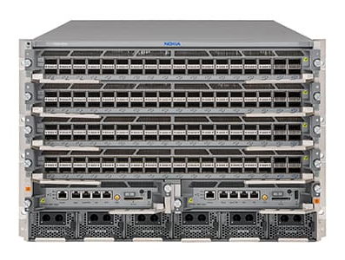
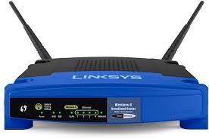
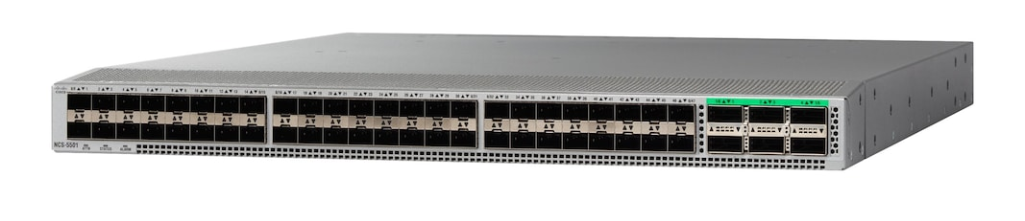
Measuring Router Size
Different dimensions for measuring the size of a router:
Physical size, number of ports, bandwidth.
Capacity = number of ports × speed of each port.
The speed of a port is sometimes called its line rate.
Example:
A home router might have four 100 Mbps ports, and one 1 Gbps port.
Total capacity: 1.4 Gbps.

Slide 7
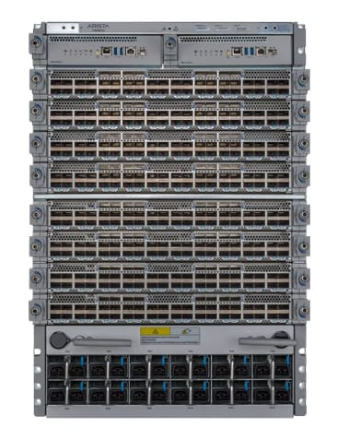
Modern Router Capacity
Modern router:
288 ports.
400 Gbps line rate per port.
Capacity = 115.2 Tbps.
Next-generation router:
288 ports.
800 Gbps line rate per port.
Capacity = 230 Tbps.
Innovation is focused on improving line rate, since we're running out of physical space to add more ports.

Slide 8
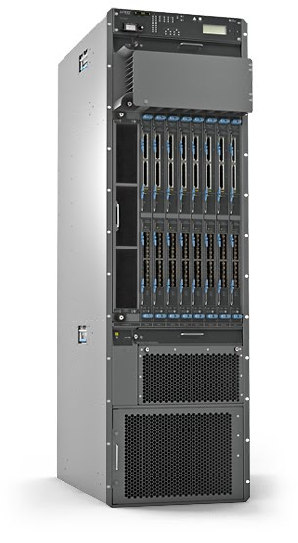
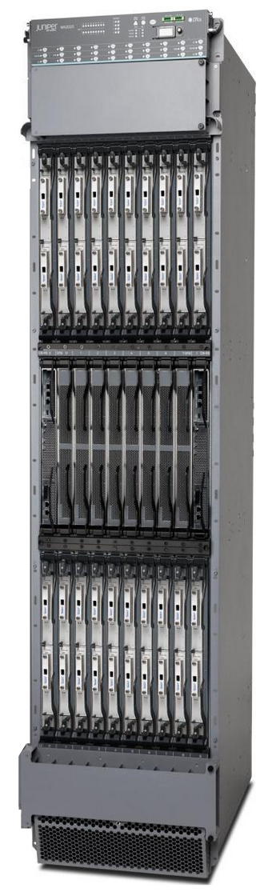
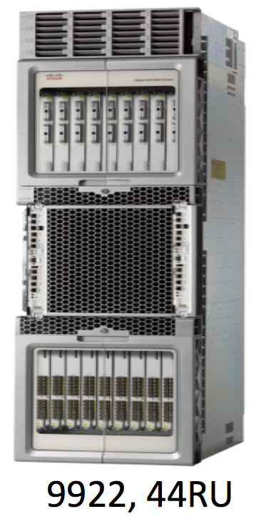
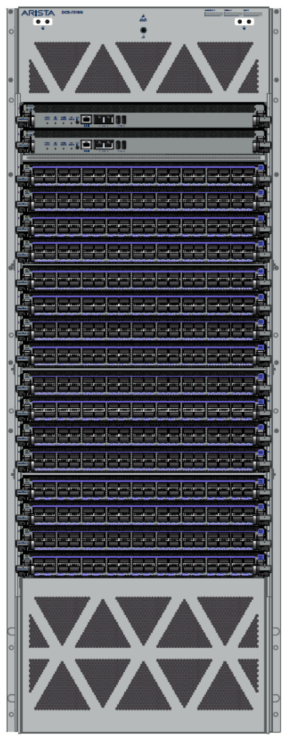
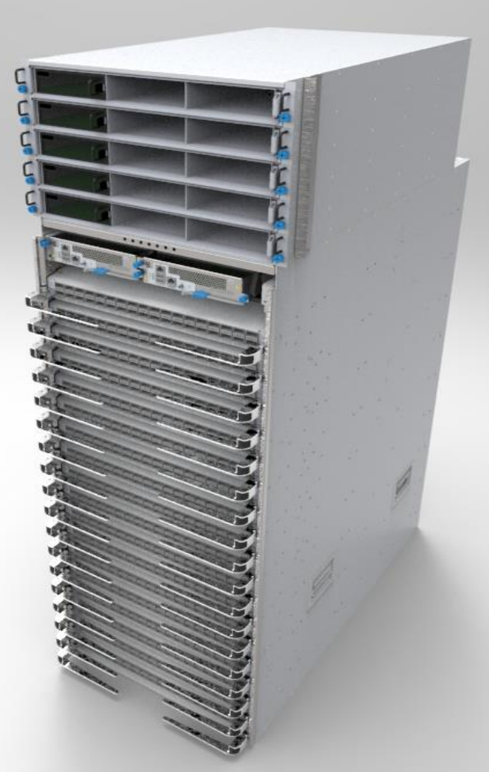
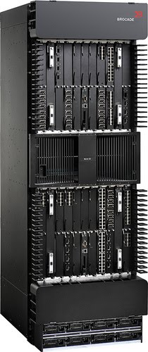
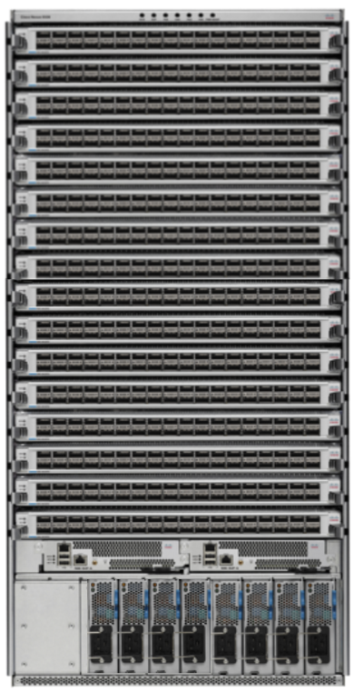
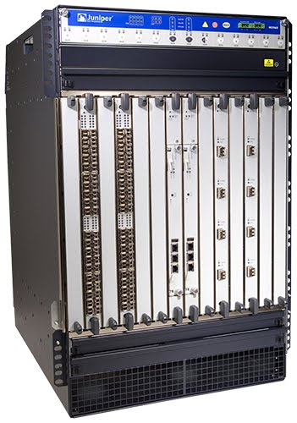
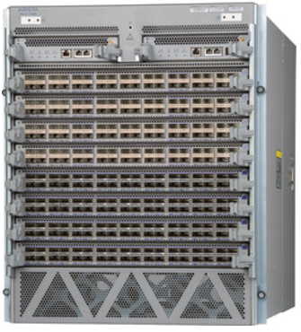
Evolution of Router Capacity
Modern routers are facing physical constraints: size, power, cooling, etc.
Rate of growth is slowing: 10G → 100G → 400G → 800G.
Juniper/Cisco/
Arista lean core
Juniper/Cisco/
Arista lean core
Juniper/Cisco/
Arista lean core
Brocade MLXe
Juniper PTX5000
Cisco ASR9000
Arista 7500R
Juniper MX3D
Juniper MX2020
28T
50T+
100T+
200T+
1.76T
2.56T
3.84T
8T
16T
10G
100G
400G
2010
2011
2012
2013
2014
2015
2016
2017
2018
2019

Slide 9
Router Components (Planes)
IP Routers
Routers in Real Life
Router Components (Planes)
Packet Types
Forwarding in Hardware
Efficient Forwarding with Tries
Lecture X, CS 168, Fall 2024

Slide 10
Router Planes
The components of a router can be split into 3 planes:
The data plane handles forwarding packets.
Used every time a packet arrives: Nanosecond time scale.
Operates locally. No coordinating with other routers.
The control plane performs routing protocols.
Used every time the network topology changes. Second time scale.
The management plane lets the operator interact with the router.
Operator uses network management system (NMS) to interact with router.
Tell the router what to do, and monitor what the router is doing.
Time scale of seconds/minutes.
Example: Assigning costs to links.
Example: How much traffic is being sent on each link?
Each plane is optimized for its tasks and its time scale.

Slide 11
What's Inside a Router? – View of Components
Chassis
Chassis: The metal box holding the hardware.
Controller Card
Control processor: Runs routing protocols and puts forwarding tables on linecards.
Also handles management plane.
CPU
Linecard
Removable linecards gives us flexibility in scaling the router. 1–20 linecards per chassis.
CPU
Linecard
CPU
Each linecard has several ports. A port can be used for both input/output.
Linecard
CPU
Each linecard has some hardware to control its functionality.

Slide 12
What's Inside a Router? – View of Links
Chassis
Controller Card
Controller card is connected to the linecards.
Linecard
Fabric
Linecard
Each linecard is connected to the fabric: A bunch of wires providing high-bandwidth, fault-tolerant interconnection between linecards.
Linecard
Linecard
Linecard
Linecard

Slide 13
What's Inside a Router? – View of a Linecard
Linecard
CPU
Forwarding Chip
Forwarding Chip
Specialized hardware optimized to forward packets.
Fabric Chip(s)
Sends packets into the fabric, to other ports on the router.
To Fabric

Slide 14
What's Inside a Router? – Full View
Chassis
Controller Card
Control Processor (x86)
Linecard
Linecard
Fabric
Fabric
Forwarding Chip(s)
Fabric Chip(s)
Fabric
Fabric Chip(s)
Forwarding Chip(s)
Local CPU (x86)
Local CPU (x86)

Slide 15
What's Inside a Router? – Data Plane
Data: Packet travels from port to port, via forwarding chips and fabric.
Chassis
Controller Card
Control Processor (x86)
Linecard
Linecard
Fabric
Fabric
Forwarding Chip(s)
Fabric Chip(s)
Fabric
Fabric Chip(s)
Forwarding Chip(s)
Local CPU (x86)
Local CPU (x86)

Slide 16
What's Inside a Router? – Control Plane
Control: Controller card talks with other routers, and programs linecards with routes.
Chassis
Controller Card
Routing Protocol
Other Routers
Control Processor (x86)
Linecard
Linecard
Fabric
Fabric
Forwarding Chip(s)
Fabric Chip(s)
Fabric
Fabric Chip(s)
Forwarding Chip(s)
Local CPU (x86)
Local CPU (x86)

Slide 17
What's Inside a Router? – Management Plane
Management: Controller card talks with operator.
Chassis
Controller Card
Configuration System
Configuration
Diagnostics
Monitoring System
Control Processor (x86)
Linecard
Linecard
Fabric
Fabric
Forwarding Chip(s)
Fabric Chip(s)
Fabric
Fabric Chip(s)
Forwarding Chip(s)
Local CPU (x86)
Local CPU (x86)

Slide 18
What's in a Router?
A router is really a cluster of computers specialized for forwarding packets.
"06" = 6 slots:
2 controllers, 4 linecards
Linecard
Fan Tray
Controller Card

Slide 19
Packet Types
IP Routers
Routers in Real Life
Router Components (Planes)
Packet Types
Forwarding in Hardware
Efficient Forwarding with Tries
Lecture X, CS 168, Fall 2024

Slide 20
Types of Packets
3 types of packets can arrive at a router.
User packet: The router needs to forward this packet toward its destination.
Most common type of packet.
Forwarding chip looks up which port to forward this packet.
If outgoing port is on a different linecard, send packet through fabric to that linecard.
Control plane traffic: Packets intended for the router itself.
Example: Advertisements in routing protocols.
Forwarding chip sends the packet to the controller for processing.
Punt traffic: Packets intended for the user, but requiring extra processing.
Example: Packet TTL has expired. Need to send back an error message.
Forwarding chip "punts" the packet to the controller for processing.

Slide 21
Types of Packets – User Traffic
User packet: Forward according to installed routes.
Chassis
Controller Card
Control Processor (x86)
Linecard
Linecard
Fabric
Fabric
Forwarding Chip(s)
Fabric Chip(s)
Fabric
Fabric Chip(s)
Forwarding Chip(s)
Local CPU (x86)
Local CPU (x86)

Slide 22
Types of Packets – Control Plane Traffic
Control plane traffic: Packets destined for this router (e.g. routing advertisement).
Chassis
Controller Card
Control Processor (x86)
Linecard
Linecard
Fabric
Fabric
Forwarding Chip(s)
Fabric Chip(s)
Fabric
Fabric Chip(s)
Forwarding Chip(s)
Local CPU (x86)
Local CPU (x86)

Slide 23
Types of Packets – Punt Traffic
Punt traffic: User packets that need extra processing (e.g. TTL expired).
Chassis
Controller Card
Control Processor (x86)
Linecard
Linecard
Fabric
Fabric
Forwarding Chip(s)
Fabric Chip(s)
Fabric
Fabric Chip(s)
Forwarding Chip(s)
Local CPU (x86)
Local CPU (x86)

Slide 24
Scaling Routers
Why build routers like this? Why not just use a general-purpose CPU?
Reason: Scale.
Assuming 64-byte packets and 400 Gbps, we have to process 781 million packets, per second, per port.
Across 36 ports, the router has to process 56 billion packets per second.
We can't achieve this scale in software.
You could write software to forward one packet per 10ms = 0.00001s.
We need to forward one packet per 10ns = 0.00000001s.
Router functionality must be implemented directly on hardware.
User packets take the "fast path" in hardware.
Only use the "slow path" in software when necessary.

Slide 25
Forwarding in Hardware
IP Routers
Routers in Real Life
Router Components (Planes)
Packet Types
Forwarding in Hardware
Efficient Forwarding with Tries
Lecture X, CS 168, Fall 2024

Slide 26
Forwarding Pipeline (1/3)
When a packet arrives, what does the input linecard need to do?
1. Receive the packet from other systems.
PHY (physical layer): Decode the optical/electrical signal into 1s and 0s.
MAC (link layer): Perform link-layer operations.
These are implemented in hardware.
PHY
MAC
Hardware

Slide 27
Forwarding Pipeline (2/3)
When a packet arrives, what does the input linecard need to do?
2. Process the packet.
Parse the packet to understand its headers, e.g. IPv4 or IPv6.
Look up the next hop in the forwarding table.
Update the packet.
Decrement TTL, update checksum, fragment packet if it's too big, etc.
PHY
MAC
Parse
Lookup
Actions
Hardware
Forwarding Chip

Slide 28
Forwarding Pipeline (3/3)
When a packet arrives, what does the input linecard need to do?
3. Send the packet onwards.
Fabric interconnect chip sends packets to other linkcards via inter-chassis links.
Fabric Interconnect
PHY
MAC
Parse
Lookup
Actions
To other linecards
Hardware
Forwarding Chip
Fabric Chip

Slide 29
Forwarding Pipeline – Queuing
Many possible queuing approaches: We'll assume the simplest one.
Classification: Which queue should this packet be put into?
One queue per input port? One queue per flow?
Assume no classification.
Buffer management: Should we drop packets?
Assume tail drop: Drop packet if queue is full.
Scheduling: What order do we send out packets?
Assume FIFO: Send packets in the order they arrive.
Alternate complex approaches can be used to implement business objectives.
Fabric Interconnect
PHY
MAC
Parse
Lookup
Actions
Queuing
To other linecards
Hardware
Forwarding Chip
Fabric Chip

Slide 30
Scaling Forwarding Hardware
Main challenge: Speed.
We have to forward one packet every few nanoseconds.
One chip is handling packets from many ports.
We have to do multiple operations to forward a packet.
Network processors are specialized to perform forwarding quickly.
Trade-off: The chip has limited functions. Can't run an arbitrary C program on it.
Any special processing can be punted to the controller.

Slide 31
Scaling Forwarding Hardware
How hard is it to implement operations in hardware?
Parse: Easy. Read specific bits of the packet.
Lookup: ???
Actions:
Some are easy: Update checksum, decrement TTL.
Some are harder: Special options, fragment packet if it's too big.
The Internet avoids using the harder ones. They usually require punting.
Fabric interconnect: Dedicated chip with limited features ensures speed.
Doing efficient lookup is our challenge!
Fabric Interconnect
PHY
MAC
Parse
Lookup
Actions
To other linecards
Hardware
Forwarding Chip
Fabric Chip

Slide 32
Efficient Forwarding with Tries
IP Routers
Routers in Real Life
Router Components (Planes)
Packet Types
Forwarding in Hardware
Efficient Forwarding with Tries
Lecture X, CS 168, Fall 2024

Slide 33
Efficient Forwarding
The forwarding table is a map (key-value pairs).
How do we do fast lookups?
Challenges:
Entries can contain a range of addresses, not just one.
Ranges might overlap. A destination can match multiple entries.
Naive solution: Write out the whole range.
Table gets really big.
If a route changes, we have to update tons of entries.
We need something smarter.
R2's Table
Destination | Port
2.1.1.0/24 | 5
R2's Table
Destination | Port
2.1.1.0 | 5
2.1.1.1 | 5
2.1.1.2 | 5
2.1.1.3 | 5
2.1.1.4 | 5
... | ...
2.1.1.252 | 5
2.1.1.253 | 5
2.1.1.254 | 5
2.1.1.255 | 5

Slide 34
Longest Prefix Match
We want a fast implementation of longest prefix match.
If the address matches multiple prefixes, take the most specific (longest) match.
If the address matches no prefixes, take the default route.
If there's no default route, drop the packet.
R2's Table
Destination | Port
11101000 01100101 111..... ........ | 5
11101000 01100... ........ ........ | 9
11101100 01100101 111..... ........ | 7
11111... ......... ........ ........ | 2
These two prefixes match. The first one is longer.
Destination:
11101000 01100101 11101011 11000110

Slide 35
Longest Prefix Match
Naive longest prefix match implementation:
For each prefix, check if it fully matches. If yes, add to list.
Pick the longest prefix in the list.
If list is empty, use default route (or drop).
Requires scanning every entry. O(N) runtime for table with N entries.
R2's Table
Destination | Port
11101000 01100101 111..... ........ | 5
11101000 01100... ........ ........ | 9
11101100 01100101 111..... ........ | 7
11111... ......... ........ ........ | 2
These two prefixes match. The first one is longer.
Destination:
11101000 01100101 11101011 11000110

Slide 36
Tries – Conceptual
Is there a map data structure that supports efficient longest prefix match?
We can use a more obscure data structure: Tries.
Idea: Spell out each key, one letter/digit at a time.
A node is marked blue if walking from root to that node forms a valid key.
Maybe familiar if you've taken UC Berkeley CS 61B.
Key | Value
a | 5
awls | 9
sa | 7
sad | 1
sam | 8
same | 2
sap | 12
a
5
s
w
a
7
l
d
m
8
p
1
12
s
9
e
2

Slide 37
Tries – Conceptual
Longest prefix matching on a trie:
Start at the root, and spell out the word.
Remember most recent (longest) key (blue node) you see along the way.
Stop when you're done, or fall off the tree. Return the longest key you saw.
Key | Value
a | 5
awls | 9
sa | 7
sad | 1
sam | 8
same | 2
sap | 12
Longest prefix of "sample" is "sam".
a
5
s
w
a
7
l
d
m
8
p
1
12
s
9
e
2

Slide 38
Efficient IP Lookup with Tries
Longest prefix matching on a trie:
Start at the root, and spell out the word.
Remember most recent (longest) key you see along the way.
Stop when you're done, or fall off the tree. Return the longest key you saw.
Key | Value
0.. | 1
100 | 2
101 | 3
11. | 4
001 | 5
...
0..
1
1..
00.
10.
11.
4
Longest prefix of 00100 is 001.
001
5
100
2
101
3

Slide 39
Efficient IP Lookup with Tries
Longest prefix matching on a trie:
Start at the root, and spell out the word.
Remember most recent (longest) key you see along the way.
Stop when you're done, or fall off the tree. Return the longest key you saw.
Key | Value
0.. | 1
100 | 2
101 | 3
11. | 4
001 | 5
...
0..
1
1..
00.
10.
11.
4
Longest prefix of 00100 is 0.
001
5
100
2
101
3

Slide 40
Efficient IP Lookup with Tries
Longest prefix matching also works with default route.
If you see another prefix, it will be returned over the default route.
If you finish spelling or fall off the tree without seeing any other prefix, the default is returned.
...
1
Key | Value
... | 1
0.. | 2
11. | 3
100 | 4
0..
2
1..
10.
11.
3
Longest prefix of 10100 is default.
100
4

Slide 41
Efficient IP Lookup with Tries
Runtime of longest prefix matching in a trie is constant: O(1).
We'll only visit at most 32 nodes from spelling out the IP address.
All routers have efficient longest prefix matching functionality.
Some use more complex solutions with heuristics and optimizations.
Some destinations are more popular than others.
Some ports have more destinations.
Longest prefix to external networks is /24 (e.g. you won't see a 29-bit prefix).
We could optimize for fast trie/table updates too.

Slide 42
Summary: IP Routers
Routers have different planes.
Data plane: Forward packets.
Control plane: Programming forwarding entries and handling exception packets.
Management plane: Configure and monitor router functionality.
Data plane leverages tradeoffs in software vs. hardware packet processing.
Software: Flexible but slow.
Hardware: Inflexible but fast.
Data plane challenges: Speed!
Some operations are easy, e.g. update packet header.
Longest-prefix lookup on destination address is harder. Used tries for efficiency.

